Slide 1
NCDOT ROADWAY DESIGN TOOLS
2014 NCLUG Winter Conference
Oak Thammavong
December 3, 2014
Notes:
Notes
Use mainly for Roadway production tools in combination with Microstation and Geopak.

Slide 2
Which button do I push?

Slide 3
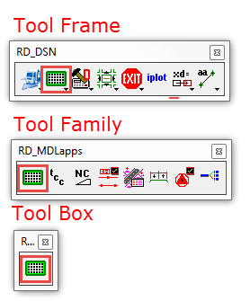
Roadway Tools Organization
Tool Frame – Tool Family – Tool Box
Example:
RD_DSN – RD_MDLapps – RD_Grid
Notes:
Added to Roadway Standard Tasks.

Slide 4
RD_DSN Tool Frame
Main Roadway Design Tools
Roadway VBA’s
Roadway MDL’s
AutoTurn (8.1), NCRemap
Roadway Reference Tools
Roadway Rotate Tools
Notes:
Updated from our legacy tools (forever).

Slide 5
SuppAtta Tool Frame
Roadway Design Supplemental Attachment Tools
Various Utilities (neat!)
Notes:
Created when I was a Technician in the mid 1990’s.

Slide 6
AutoTurn
Transoft Solution AutoTurn MDL App
Workspace Configuration - RoadwayCFG.dat
Notes:
Current version is 8.1

Slide 7
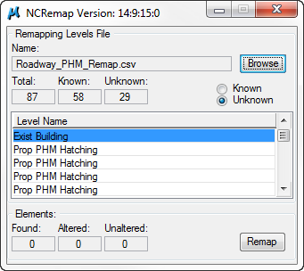
NCRemap
Created for V7 (J) to V8 Migration
Workspace CSV’s to remap levels
Notes:
Remap level number to level name. Can be used to remap level names.
C:\NCDOT_V8_WORKSPACE\ROADWAY_STDS\Standards\data

Slide 8
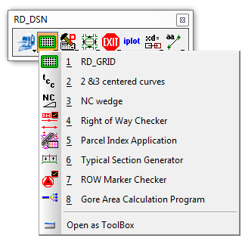
RD_MDLapps
Grouped MDL Applications (MA)
Workspace MDLApps Folder
MA’s & Some DLL’s
Notes:
C:\NCDOT_V8_WORKSPACE\ROADWAY_STDS\Standards\mdlapps

Slide 9
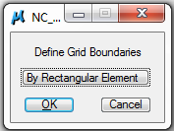
RD_Grid
Long Profile Sheet
Use NCDOT Project Scale
Three Modes:
Data Points
Fence
Rectangular Element/Shape
Top-View Required
Notes:
Demo1.dgn
(50 Scale) Border Height – 500’ Dual/1025’ Single
25’ Gap for Stations Labels
Construct Rectangular Array for Elevations
Border Length – 50’ Divisible

Slide 10
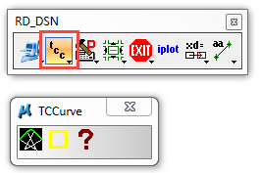
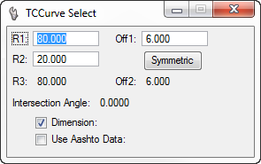
TCCurve
Three Center Curve
2004 AASHTO Exhibit 9-19 thru 9-20
Notes:
Revised this Monday.
Enhancement to trim EOT on future version.
Civil Geometry???

Slide 11
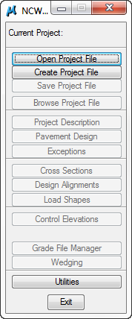
NCWedge
Roadway Sundowning Tools
Requires Geopak Shapes
GPK, XSC, & EOP
Corridor Modeling Overlay Components

Slide 12
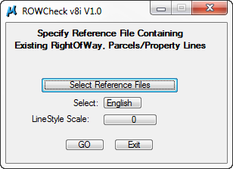
ROWCheck
Roadway Sundowning Tools
Check for Correct Level Symbology and Order of ROW and Easements
Done Before Deed Draft

Slide 13
RD_ROWParcels
ROW Parcel Index Sheet
Each Plan Sheet or Whole ROW File
Text - Not Text in Cell
Create .TXT File → Import ROWParcels.XLS
Adjust & Re-sort in ROWParcels.XLS
Notes:
Text file is “appended” not overwritten.

Slide 14
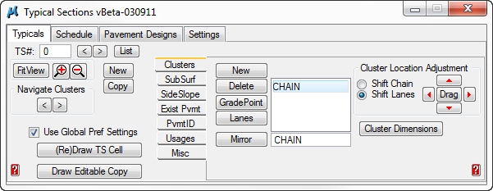
RD_TSGen
Typical Section Generator
Help Video in Roadway Workspace
May revert back to earlier simpler version
Notes:
Originally BridgeR.MA

Slide 15
SurveyControl
ROW Marker Checker for L&S
____ (10) PLACE "SURVEY CONTROL SHEETS" (APPLICABLE TO PROJECTS SENT TO R/W AFTER 03-01-2003) IN THE 1 SERIES OF SHEETS AFTER THE "CONVENTIONAL SYMBOLS" SHEET.
Notes:
B5239_ls_1c.dgn
Check if needed.

Slide 16
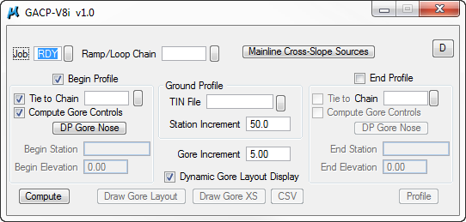
GACP
Gore Area Computation Program
Roadway Sundowning Tools
Geopak Shapes
Online Help
Corridor Modeling – Gore Tools

Slide 17
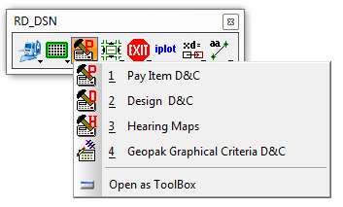
RD_DDB
Various Roadway Design & Computation (D&C) Manager Tools
May be sundowned by Bentley with SS4

Slide 18
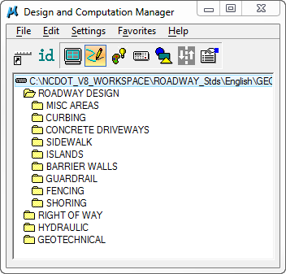
Payitems D&C Manager
Associated pay items for estimates
Automated quantities
Transport

Slide 19
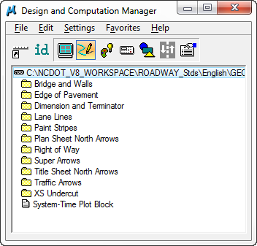
Draft/Design D&C Manager
Non-associated pay items for plans production
Maybe replaced by Element Templates

Slide 20
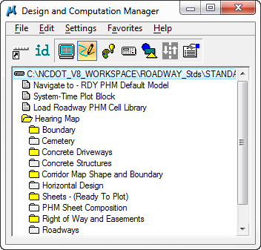
Hearing Map D&C Manager
Hearing maps
Workshop maps
Aerials

Slide 21
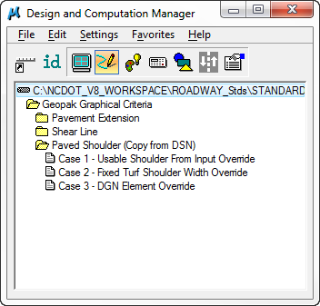
GGC D&C Manager
Geopak Graphical Criteria
Roadway sundowning tools

Slide 22
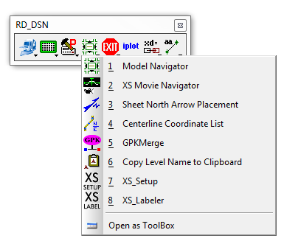
RD_VBA
Various VBA tools (not MDL applications (MA))

Slide 23
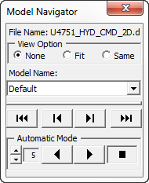
ModNav
Microstation Model Navigator
Navigate through various Microstation models in a single DGN file
Idea for cross section XPL

Slide 24
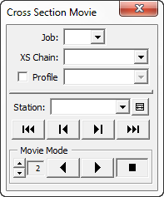
XSMovie
Cross Section Movie
Navigate through various cross sections in the XSC

Slide 25
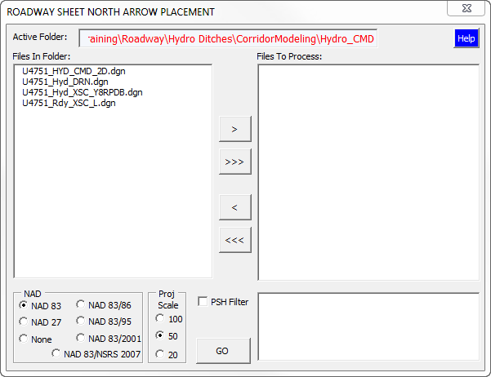
RD_SHNAP
SHeet North Arrow Placement
Uses Standard NCDOT Plan Sheet Cells

Slide 26
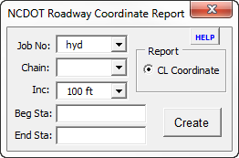
RD_CCList
Centerline Coordinate List
____ (11) PLACE "CENTERLINE COORDINATE LIST" IN NO. 1 SERIES SHEETS
AFTER "SURVEY CONTROL SHEETS" (APPLICABLE TO NEW LOCATION
PROJECTS).

Slide 27
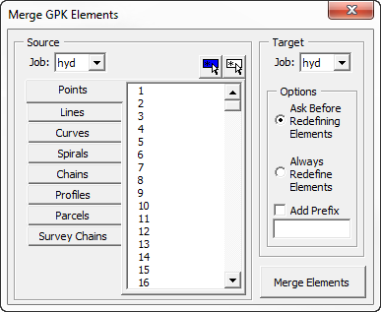
RD_GPKMerge
Copy GPK data from one GPK (source) to another (target)
Use the Job (GPK) Dir (COGO Preferences) – both must be there
Ideal for Hydro Ditch Grades and L&S ALN

Slide 28
RD_CopyLvName
Copy level name to system clipboard
Paste into any text editor
Ideal for Criteria input files – long level names
If cell, then the cell name is stored instead

Slide 29
XS_Setup
Setup before cutting cross sections – Corridor Modeling proposed DTM’s
Active level = Scratch_Level_0
Text Size = 0.02

Slide 30
XS_Labeler
Quick access to the XSLabeler without launching Corridor Modeling

Slide 31
RD_EXIT
Compress File → Exit

Slide 32
RD_iPlot
Launches iPlot

Slide 33
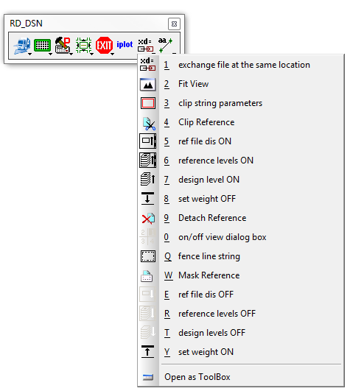
RD_Reference View Controls
Legacy tools for reference files

Slide 34
RD_AutoXD
Go to reference file at the same view locations
Old “xd=“ command
RD_AutoXD → Home = back to original file
Same as reference file “exchange”

Slide 35
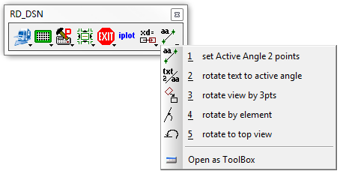
RD_User Rotate
Various rotate tools
Ideal for plan sheet productions

Slide 36
Set Active Angle 2 Points
Set active angle by two data points
Usually followed by “rotate text to active angle” command – next tool

Slide 37
Rotate Text to Active Angle
Rotate Text to Active Angle
Independent of view rotation

Slide 38
Rotate View by 3 pts
Rotate View by 3 Points
1st Point – Center Point of X-Axis
2nd Point – Point on X-Axis (horizontal to after rotation)
3rd point – the view to rotate
Use Previous View (Undo) or Next View (Redo)

Slide 39
Rotate View by Element
Rotate View (Aligned with Element)

Slide 40
Rotate View - Top
Rotate view to true north
Required for cross sections and profiles

Slide 41
SuppAtta Tool Frame
Roadway Design Supplemental Attachment Tools
Various Utilities (neat!)
Notes:
Created when I was a Technician in the mid 1990’s.

Slide 42
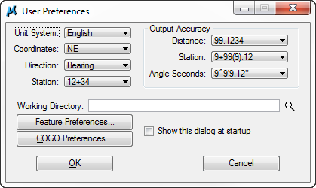
COGO Preferences (Shortcut)
Shortcut to Geopak User Preferences

Slide 43
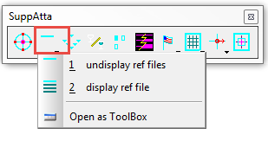
Reference Files Display
Display/Undisplay ALL referenced files

Slide 44
Graphic Group (Toggle)

Slide 45
Display Fill Shapes (Toggle)
Display Fill/Hole Shapes
Ideal for hearing map preparation

Slide 46
Angle Lock (Toggle)
Lock angle horizontal (0 degree) and vertical (90 degree)

Slide 47
Display Weight (Toggle)
Display elements in weight zero
Reduce screen clutter
Does not affect plotting

Slide 48
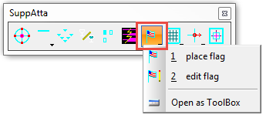
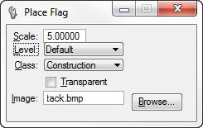
Microstation Flags
Place bitmap image (.bmp) in DGN file
Class = Construction
Ideal for notes, such as VC calculations

Slide 49
Set Active Angle
Set active angle (degree):
0
90
180
270
May expand to 45 degree increments
Ideal with User_Rotate tools
Notes:
Riprap program

Slide 50
DL=0,0
Use primary with the copy command to copy an element from a reference file to the active file at the same exact location.
Ideal for hearing maps

Slide 51
Questions?

